Slide 1

DATA ENGINEERING 1
DATA MODELING AND JOINS
Laszlo Sallo
OCTOBER 2023

Slide 2
DATA MODELING - RELATIONSHIPS

Slide 3

ONE-TO-ONE (1:1) RELATIONSHIP

Slide 4

ONE-TO-MANY (1:N) RELATIONSHIP

Slide 5

MANY-TO-MANY (M:N) RELATIONSHIP

Slide 6
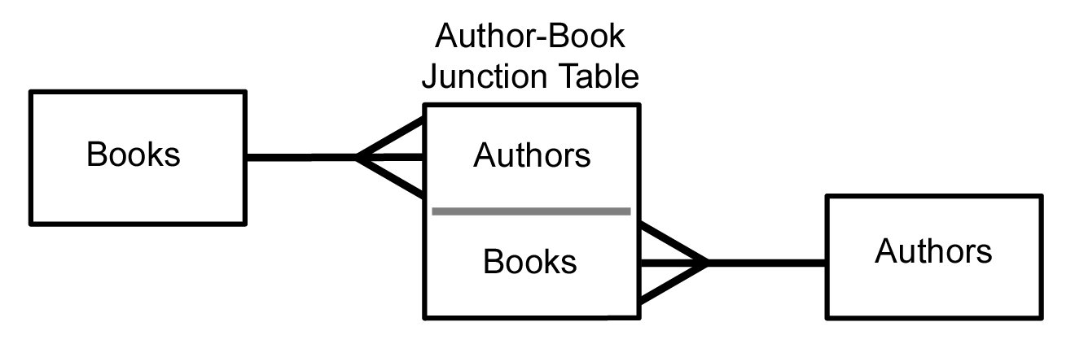
MANY-TO-MANY (M:N) RELATIONSHIP
Authors
Books
Authors
Books
AUTHORS
AUTHORS_BOOKS
BOOKS
AUTHOR_ID | AUTHOR_NAME
1 | Gene Kim
2 | Nicole Forsgren
3 | Jaroslav Hašek
4 | Jez Humble
ID | AUTHOR_ID_FK | BOOK_ID_FK
1 | 1 | 1
2 | 1 | 3
3 | 2 | 1
4 | 4 | 1
5 | 3 | 2
BOOK_ID | BOOK_TITLE
1 | Accelerate
2 | Švejk
3 | Phoenix Project

Slide 7
DATA JOINING

Slide 8
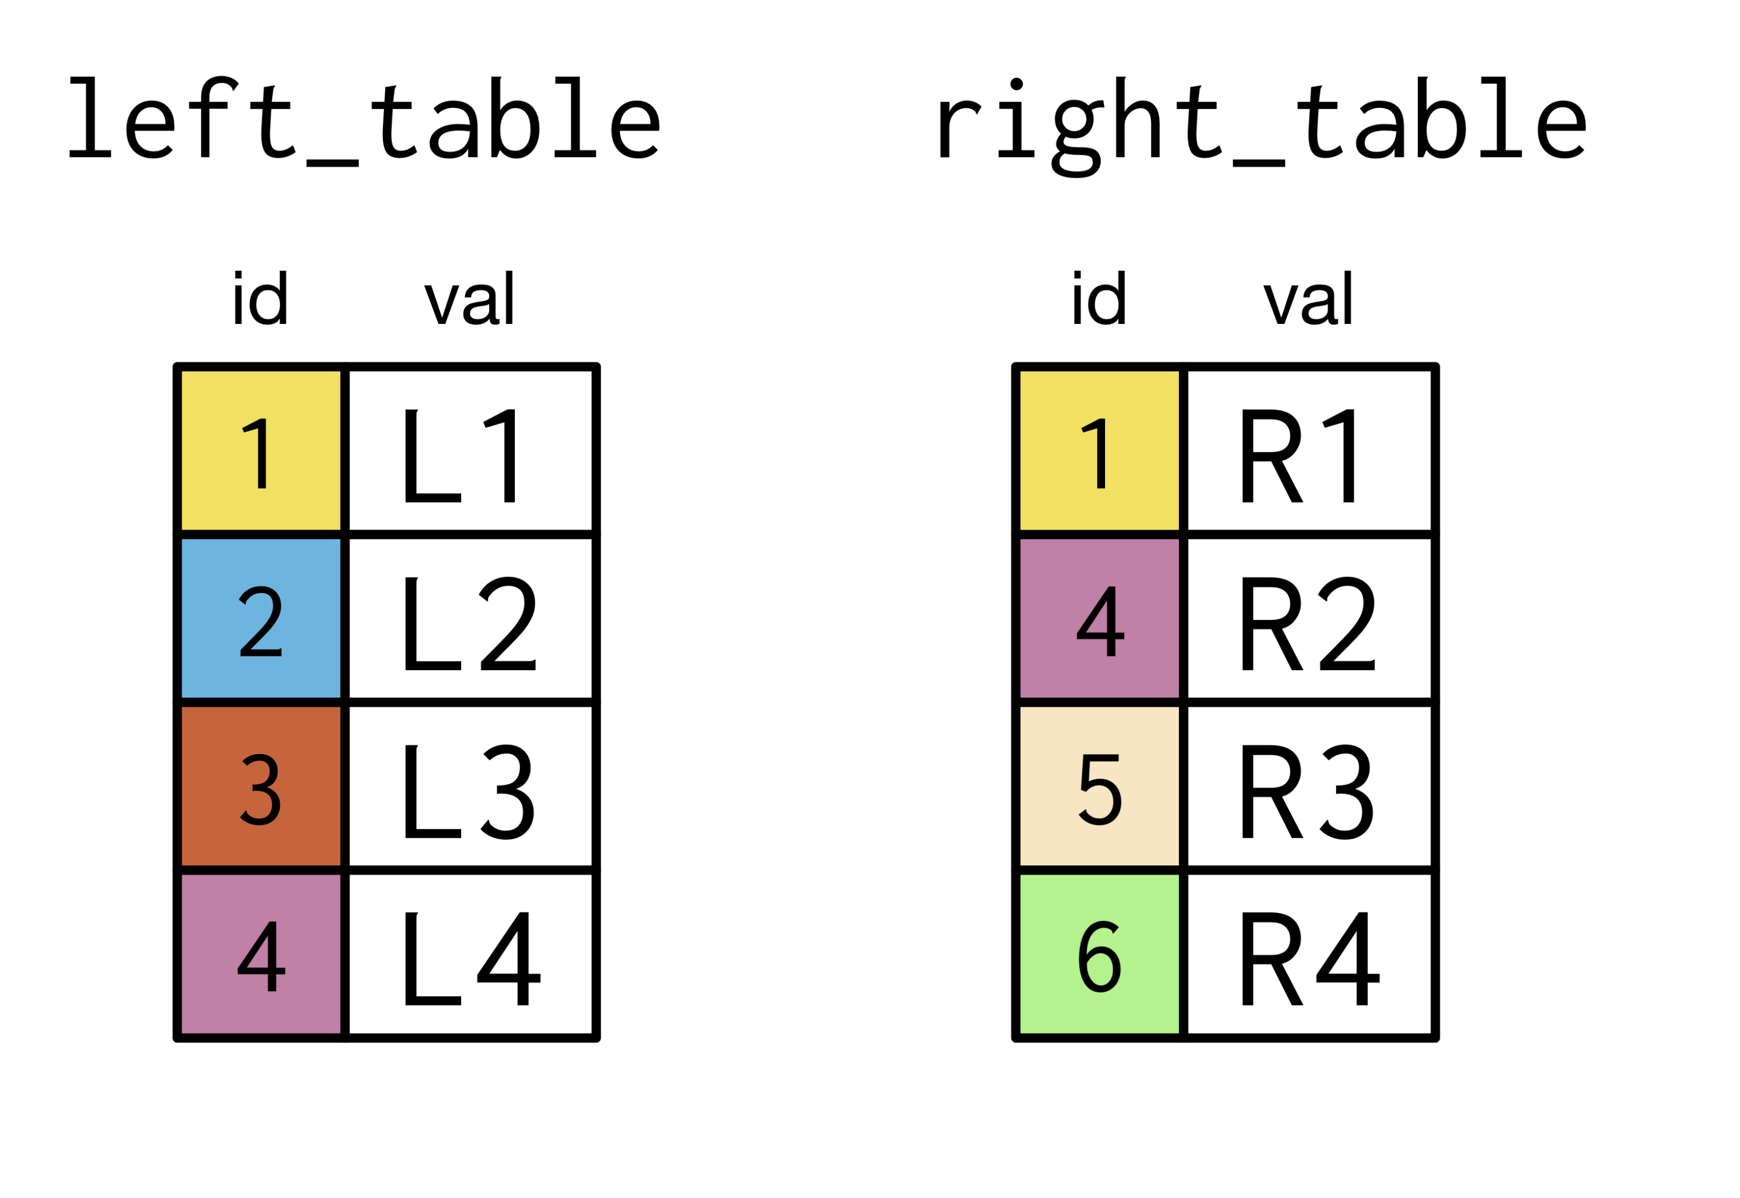
INNER JOIN

Slide 9
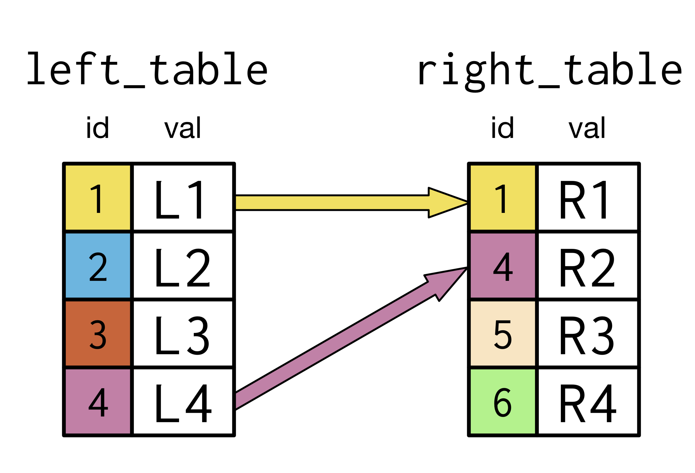
INNER JOIN

Slide 10
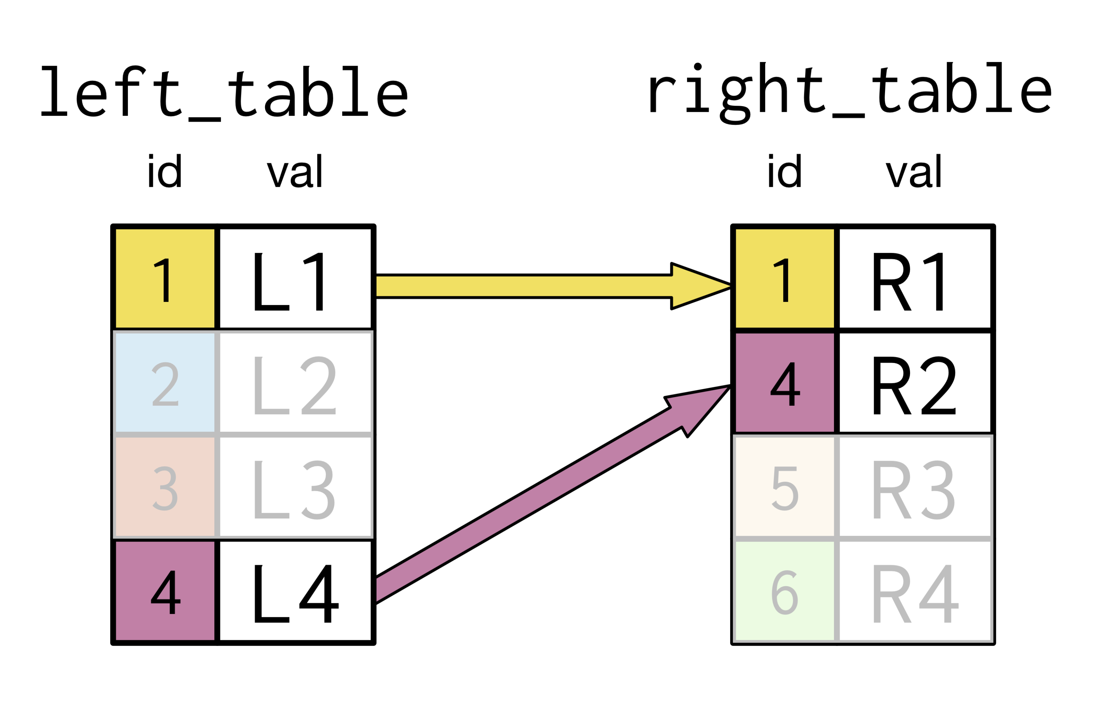
INNER JOIN

Slide 11
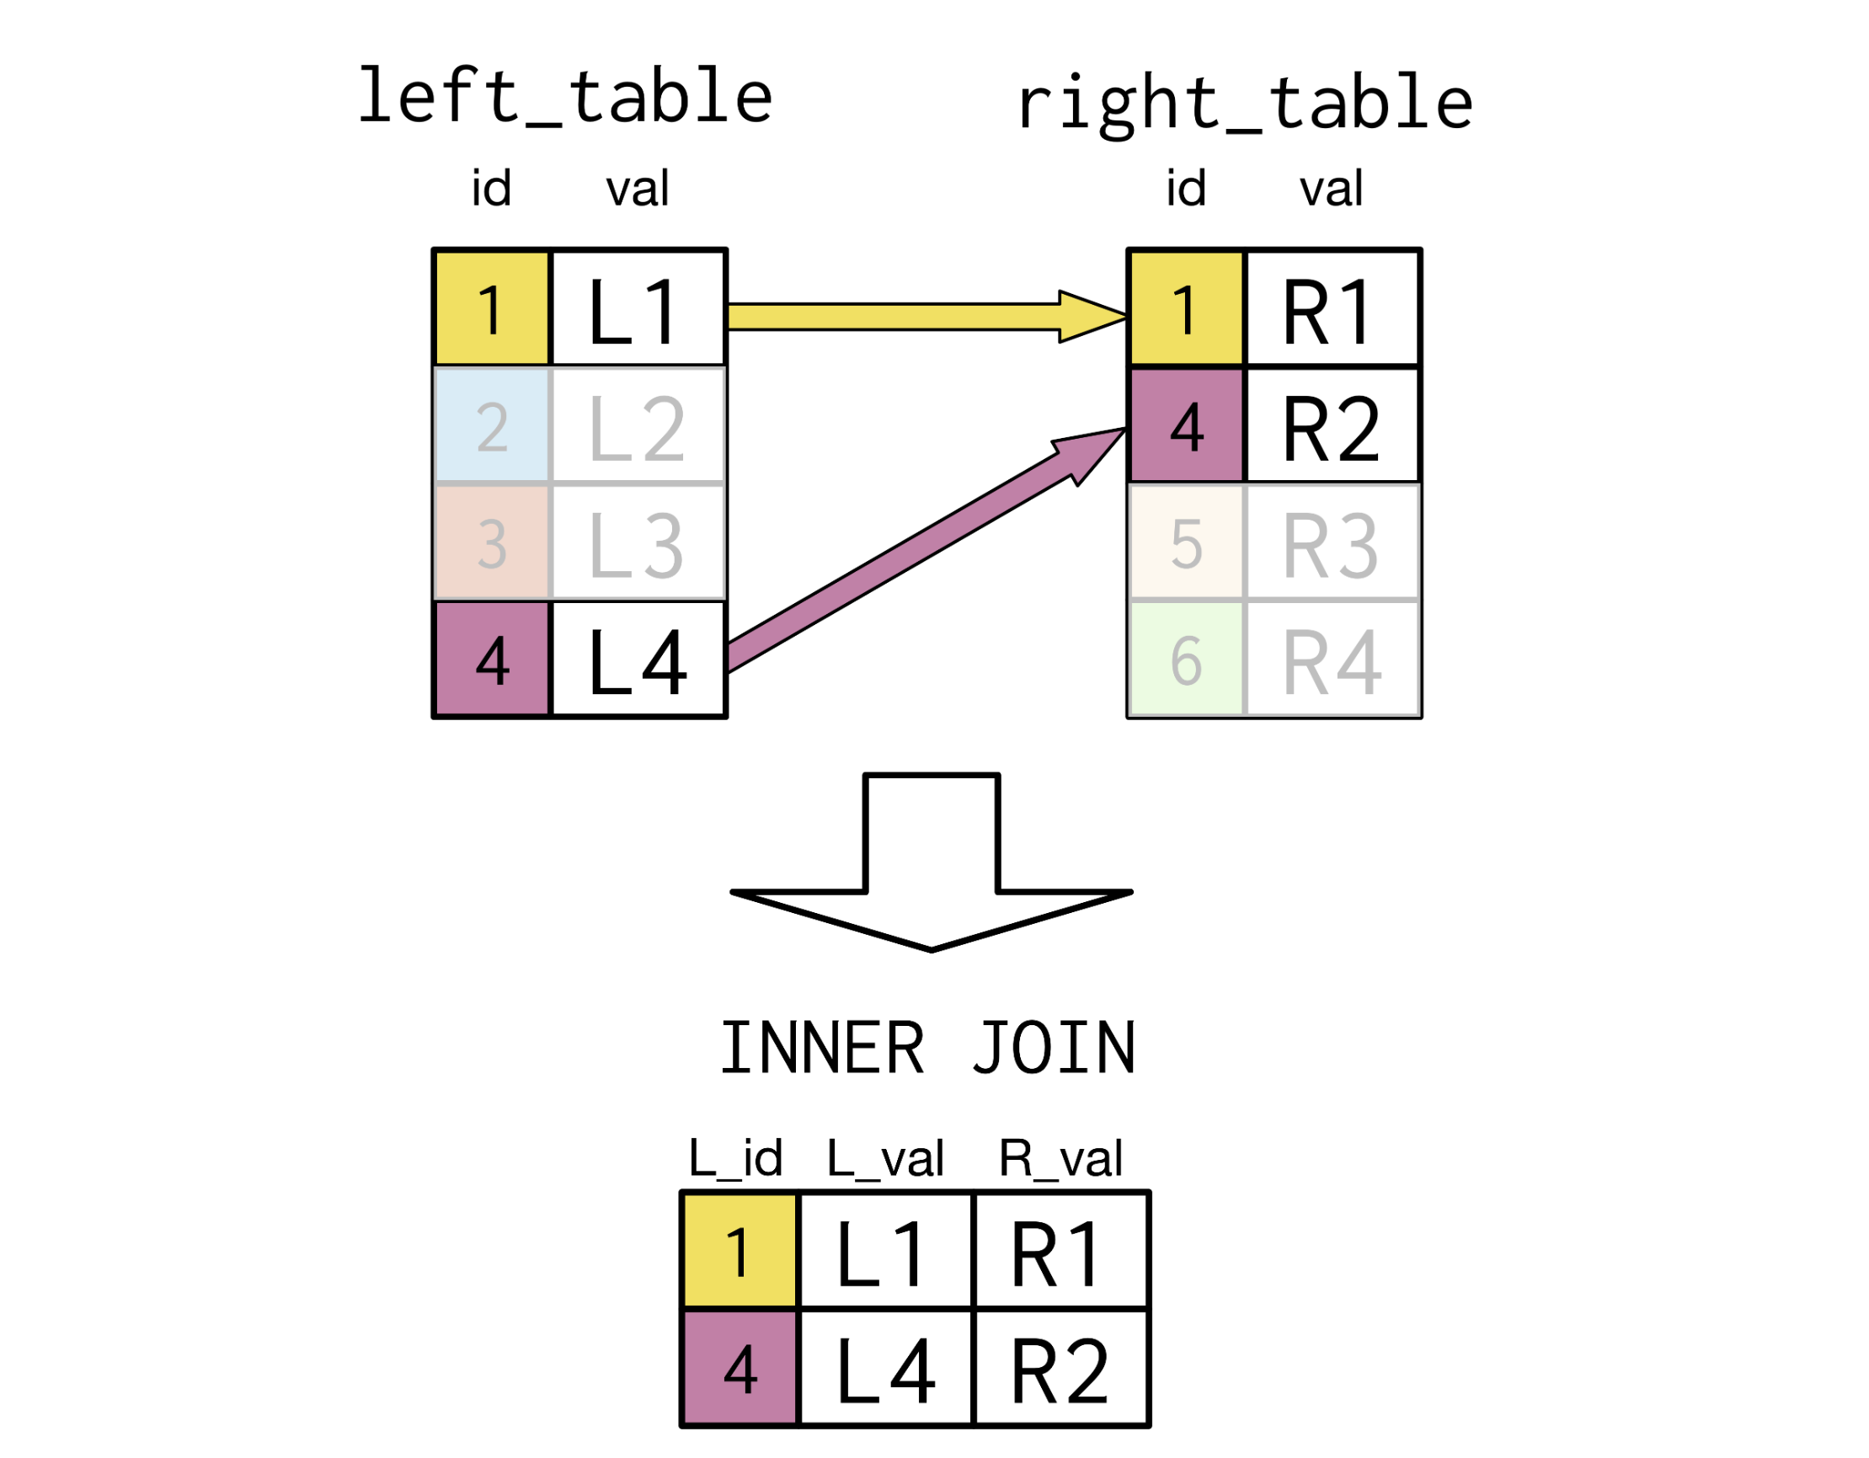
INNER JOIN 1:1

Slide 12
INNER JOIN 1:N

Slide 13
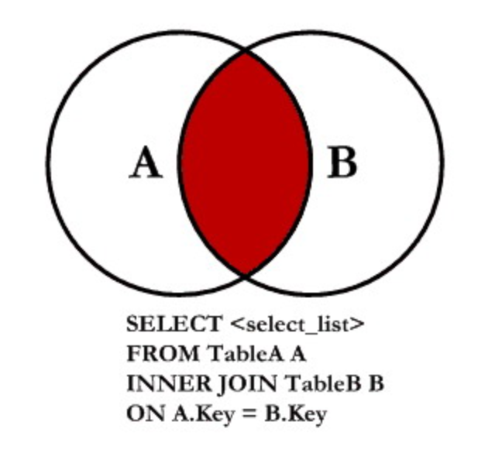
INNER JOIN FORM

Slide 14
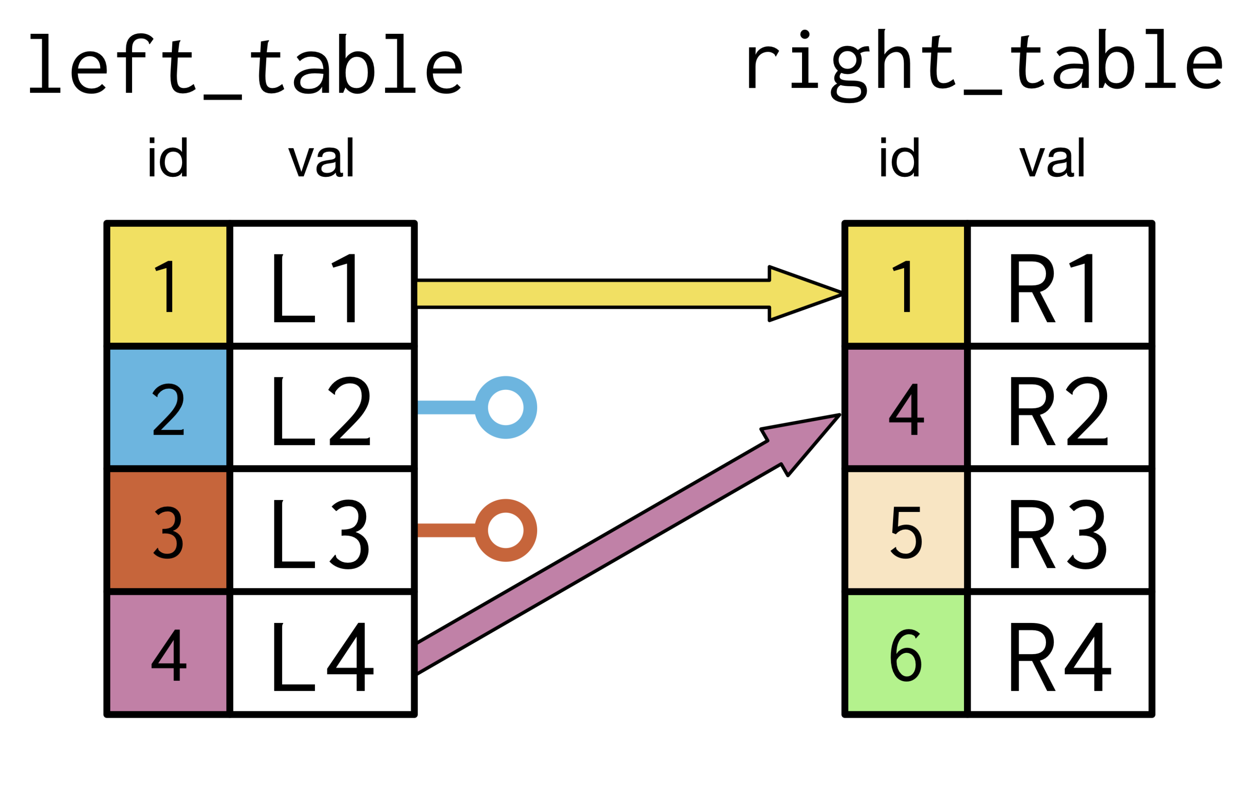
LEFT JOIN

Slide 15
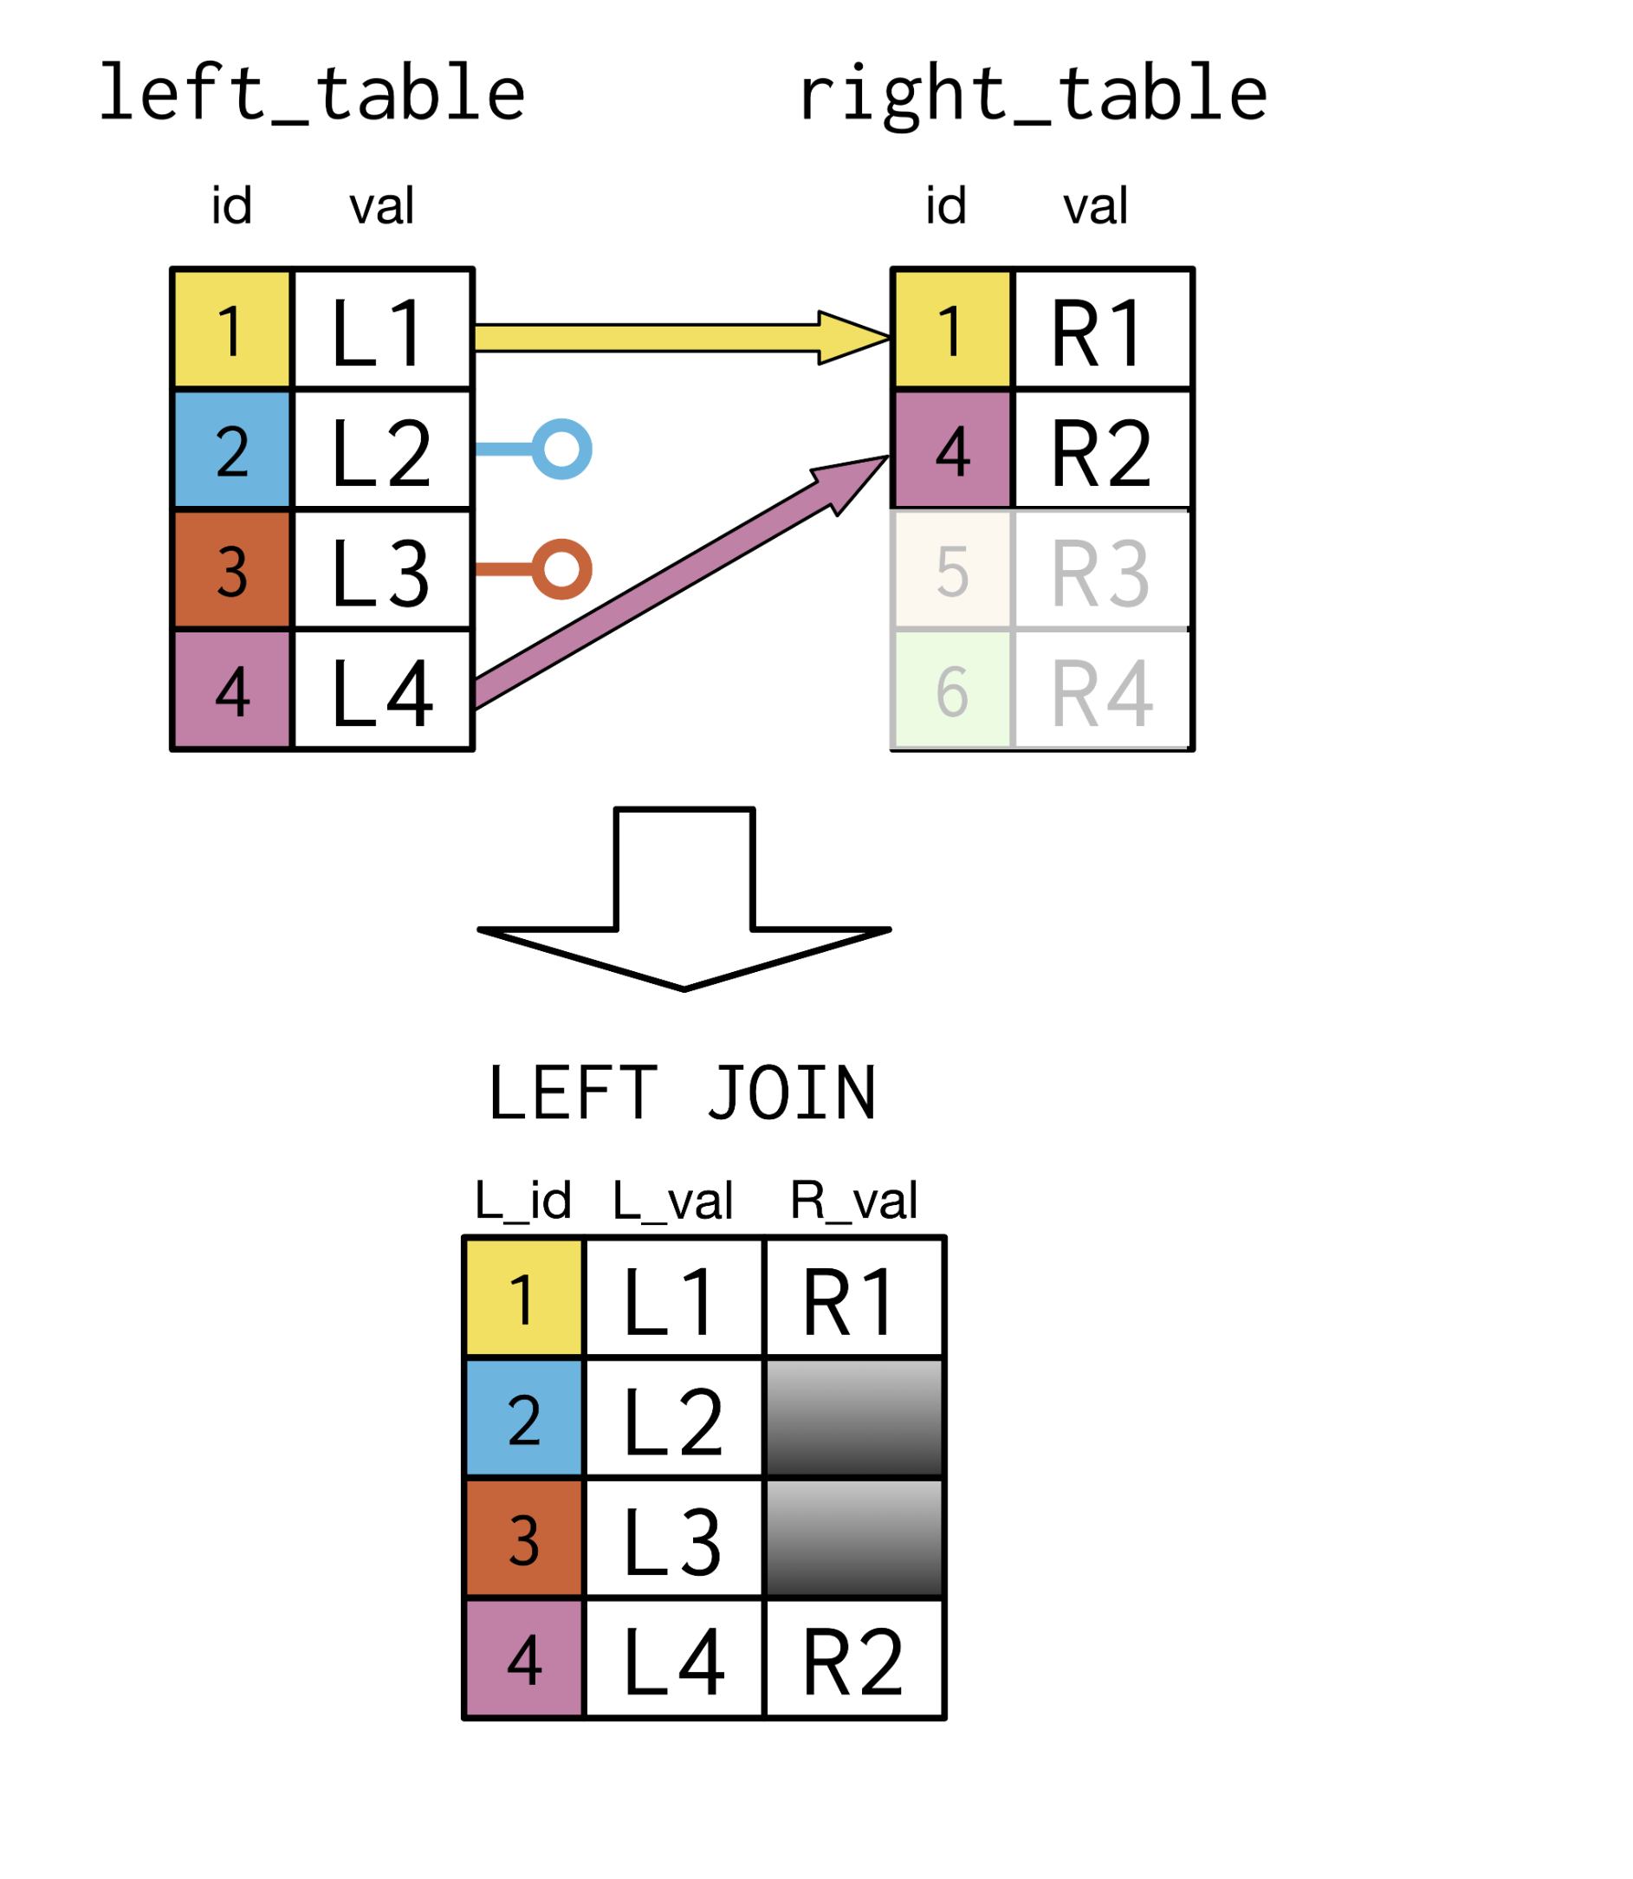
LEFT JOIN 1:1

Slide 16
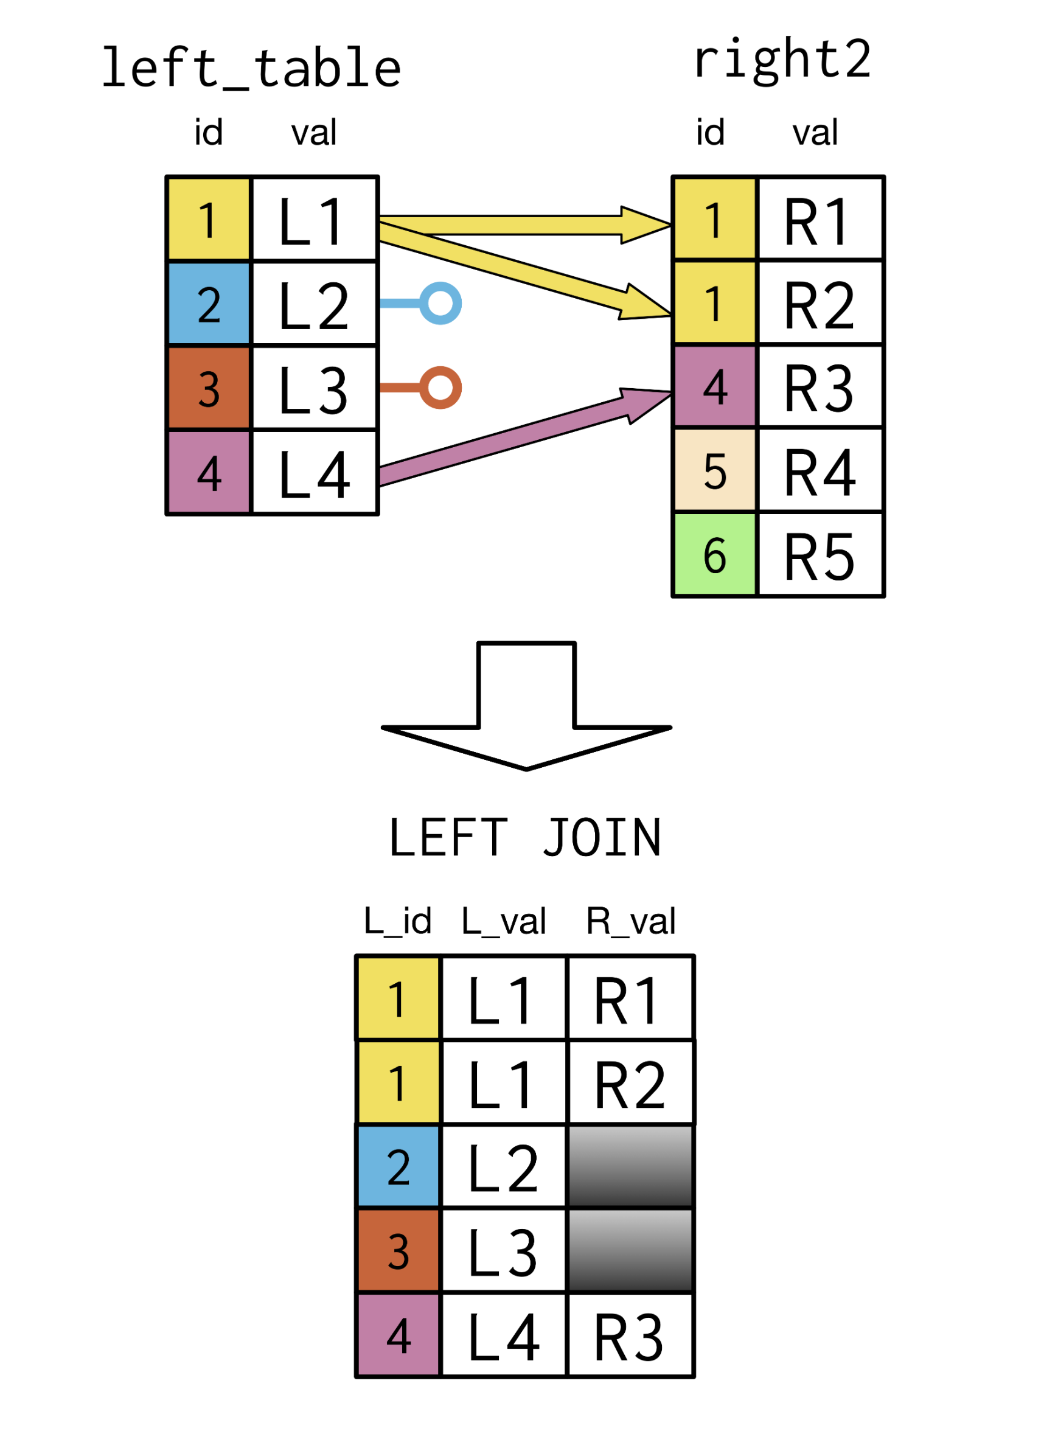
LEFT JOIN 1:N

Slide 17
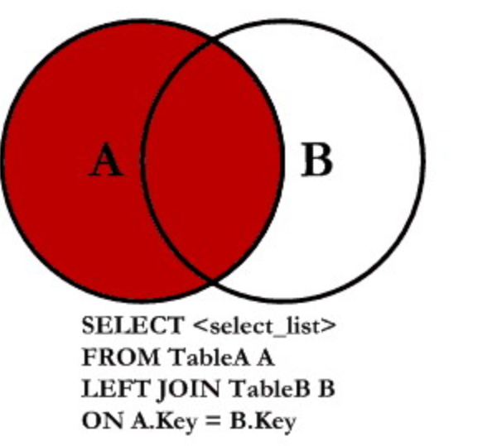
LEFT JOIN FORM

Slide 18
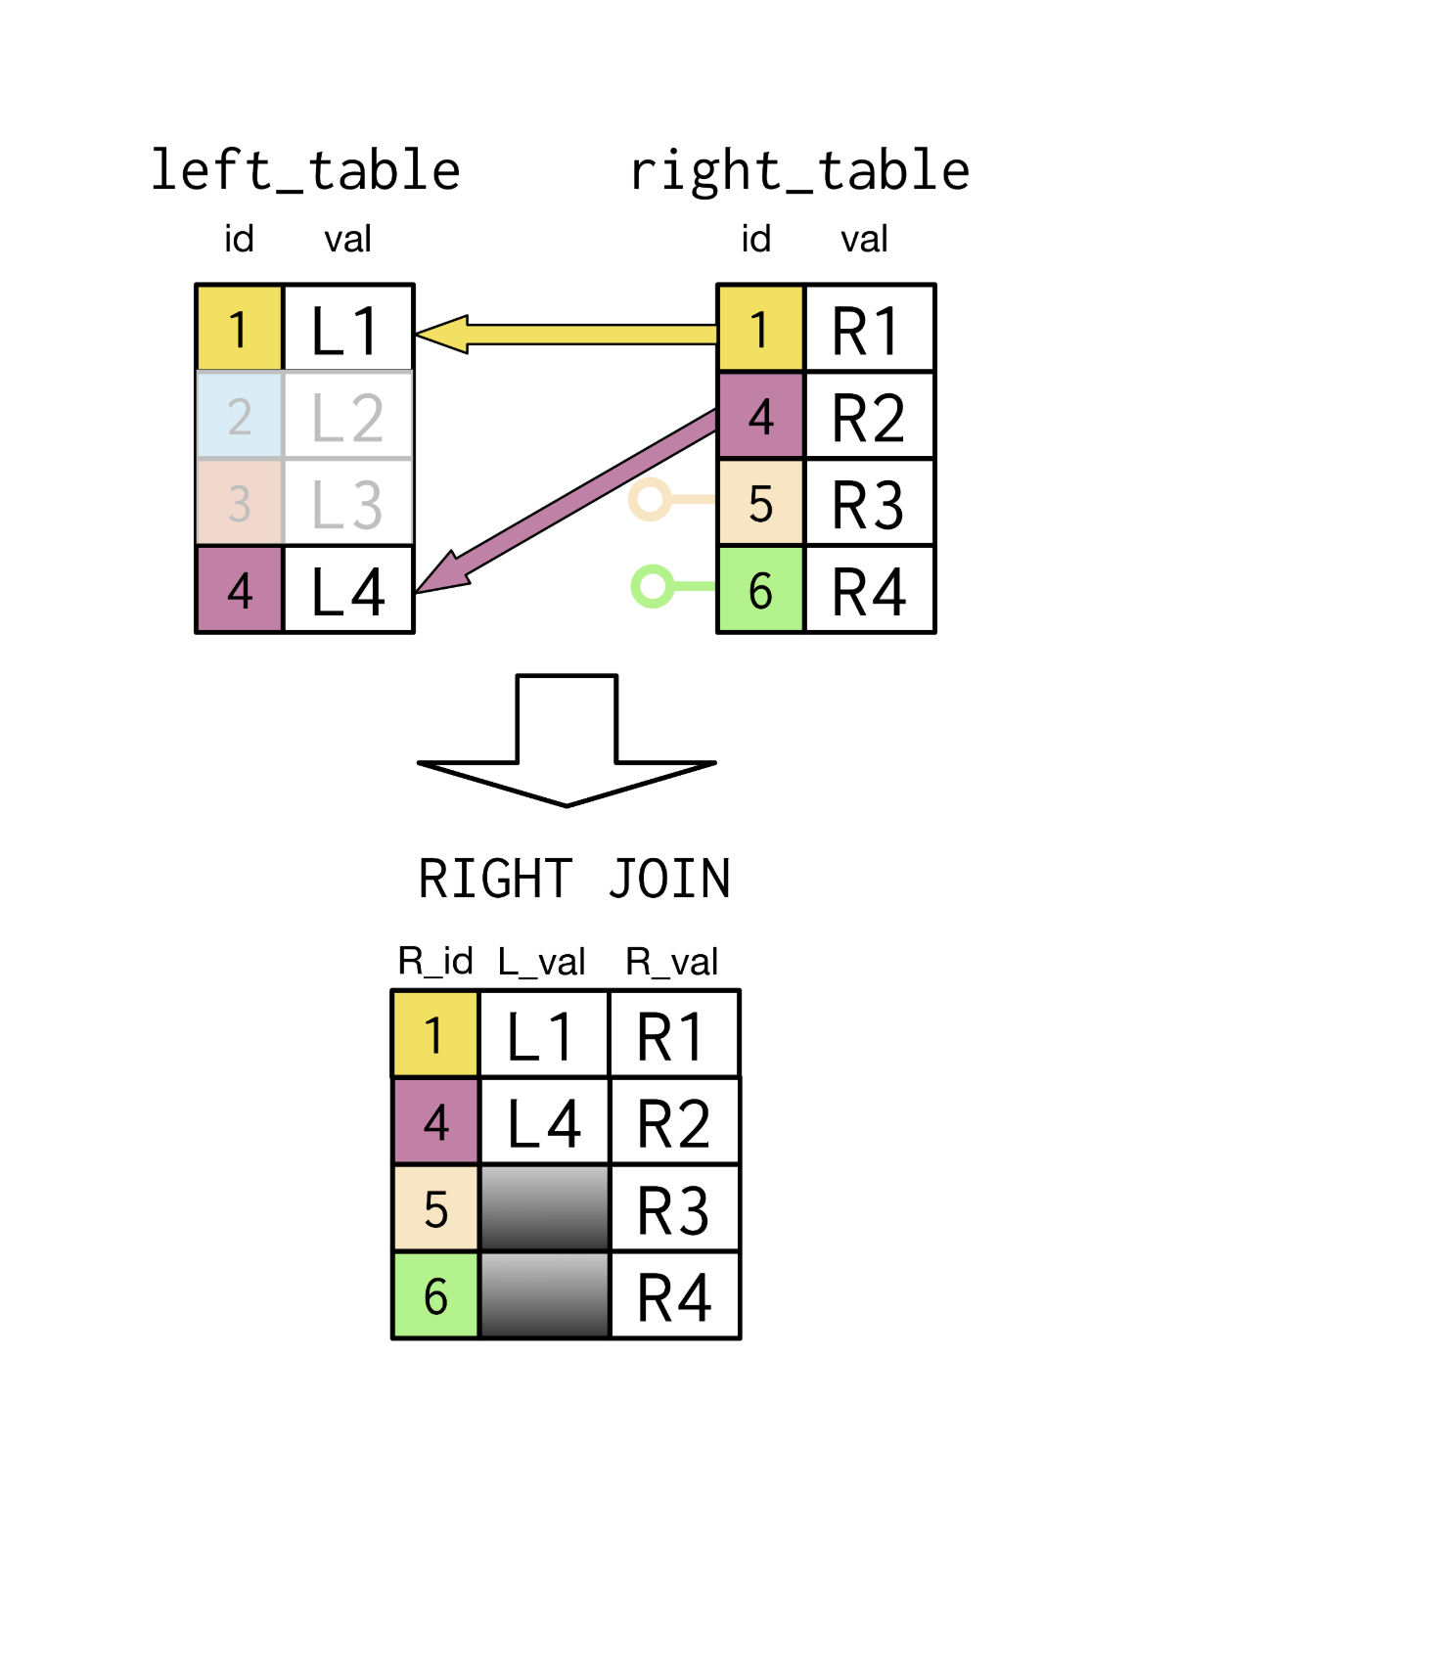
RIGHT JOIN

Slide 19
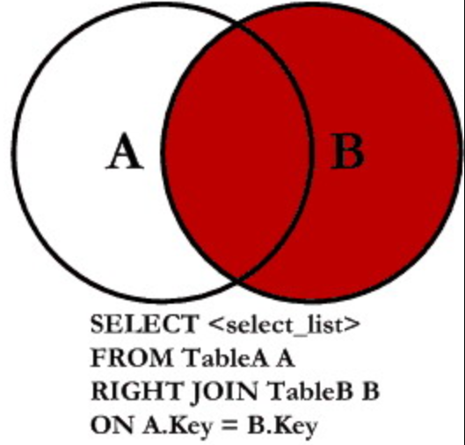
RIGHT JOIN FORM

Slide 20
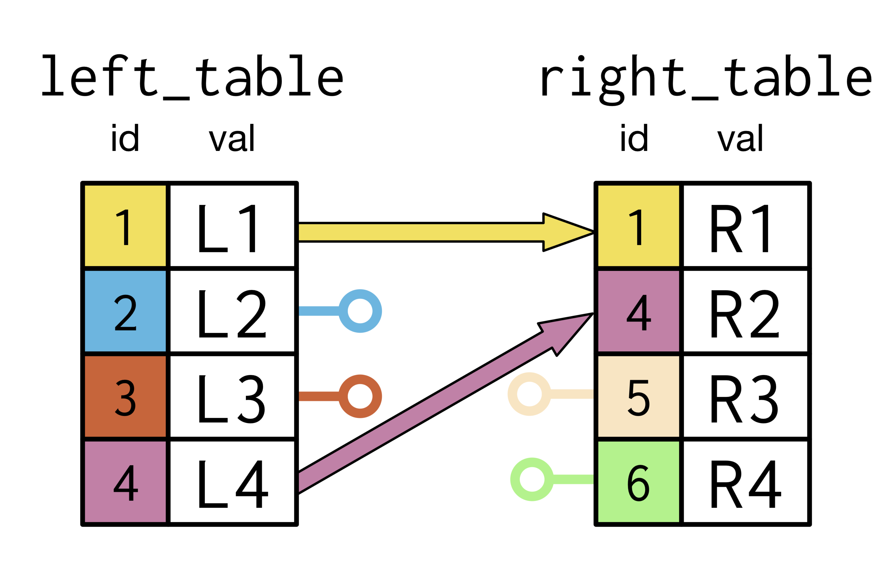
FULL JOIN

Slide 21
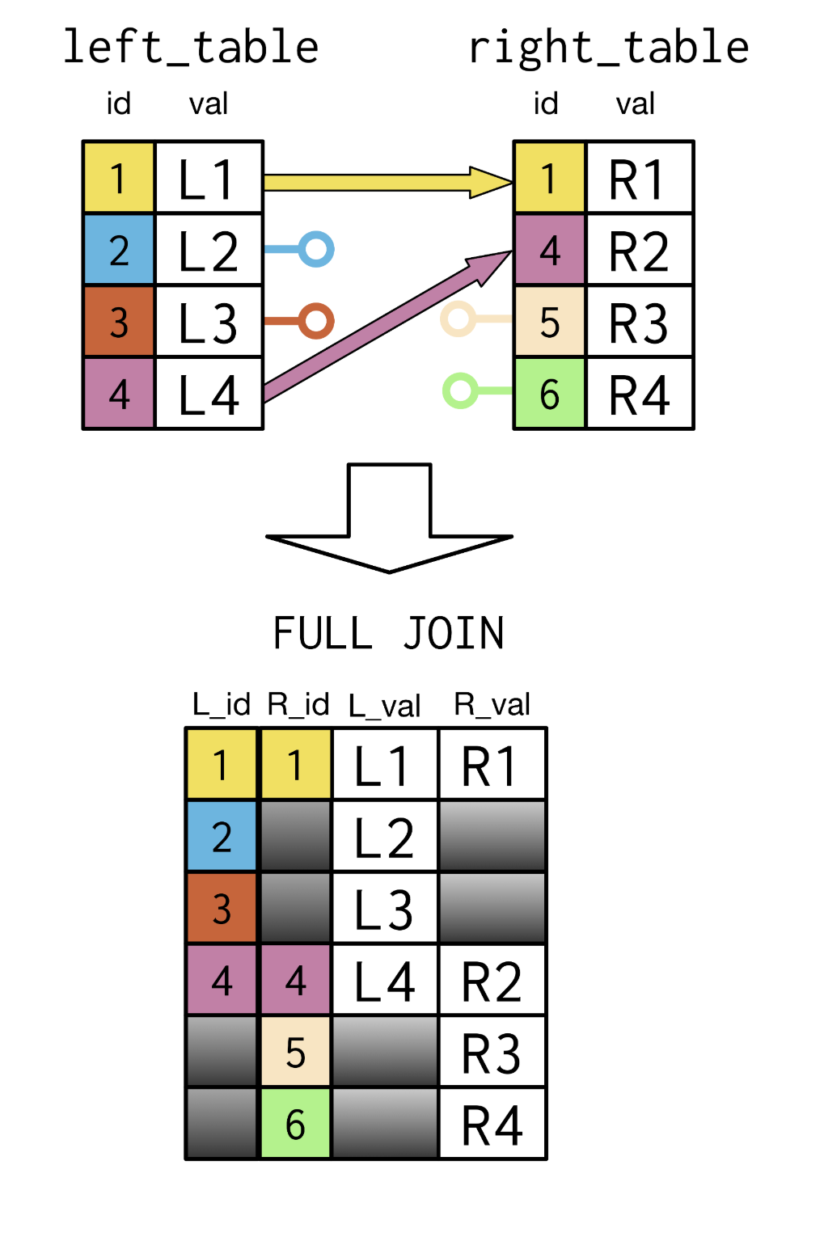
FULL JOIN

Slide 22
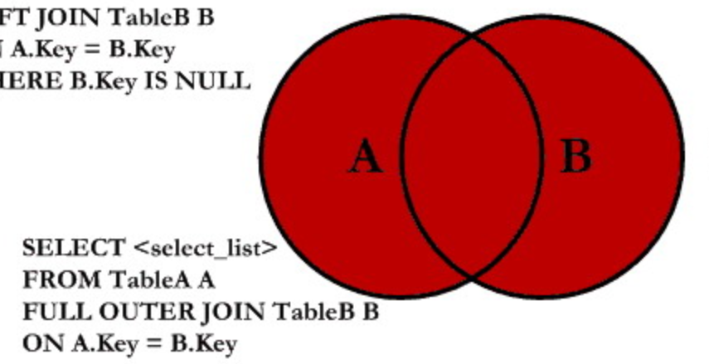
FULL JOIN FORM

